Slide 1
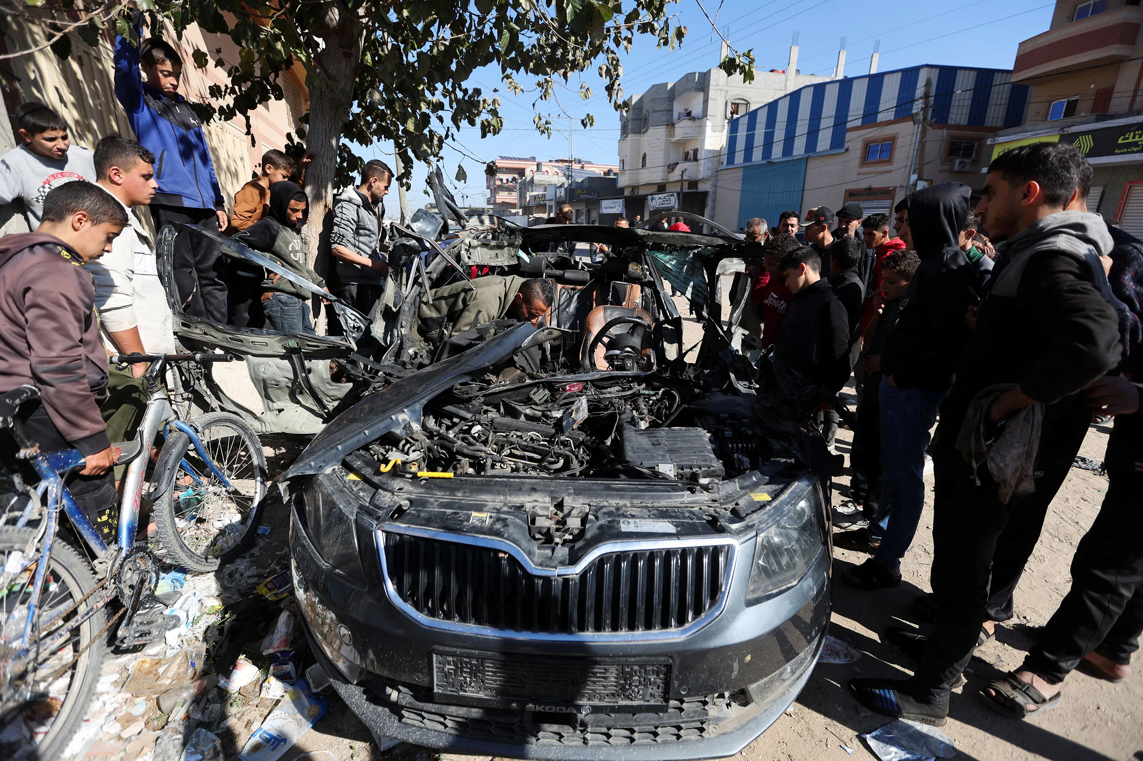
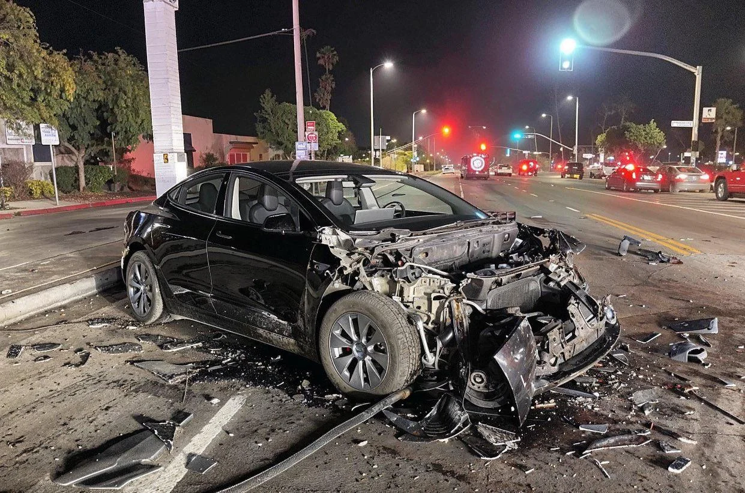
Which is Real?

Slide 2
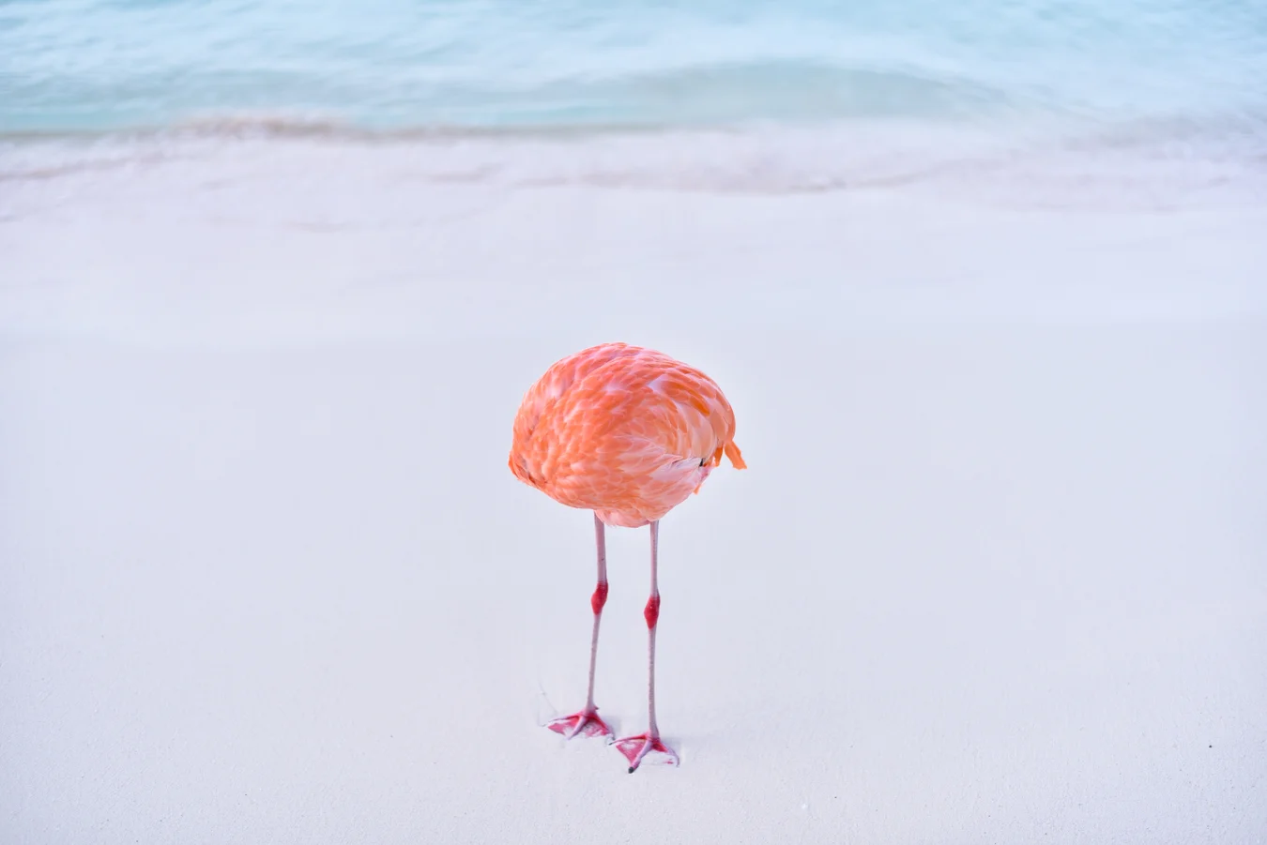
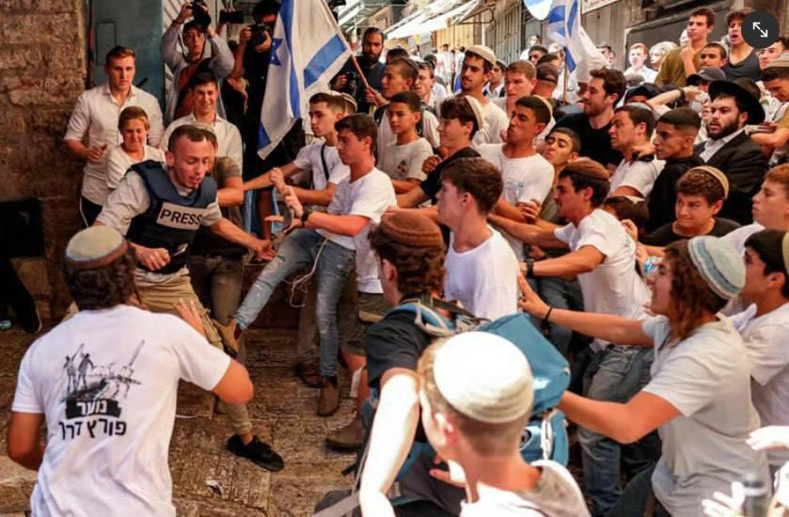
Which is Real?

Slide 4
Identifying Synthetic Content
Notes:
Start by creating a slide master that is in English. As needed duplicate and translate slides into target language. Color English slides in Yellow and target language slides in white. The example below uses Spanish as a theoretical target language.

Slide 5
Lesson Objectives
Identify AI-generated content effectively using specific detection techniques for images, text, and audio.
Detecting Synthetic with the human eye alone is limited
References:
Media Lab at MIT on Detecting Fakes
Detect Fakes with Kellogg's online tool
CISA Contextualizing Deepfake Threats to Organizations
DARPA: Deepfake Defense Tech Ready for Commercialization, Transition
Notes:
"AI Generated Content is becoming increasingly sophisticated and harder to detect. There will be many situations where it is not possible to determine if content is AI-generated or not. More advanced technical tools and techniques are required to detect AI-generated content."

Slide 6
Synthetic Check: Human Image
Context of the scene
Hands and limbs of people
Face and facial features
Clothes and items

Slide 7
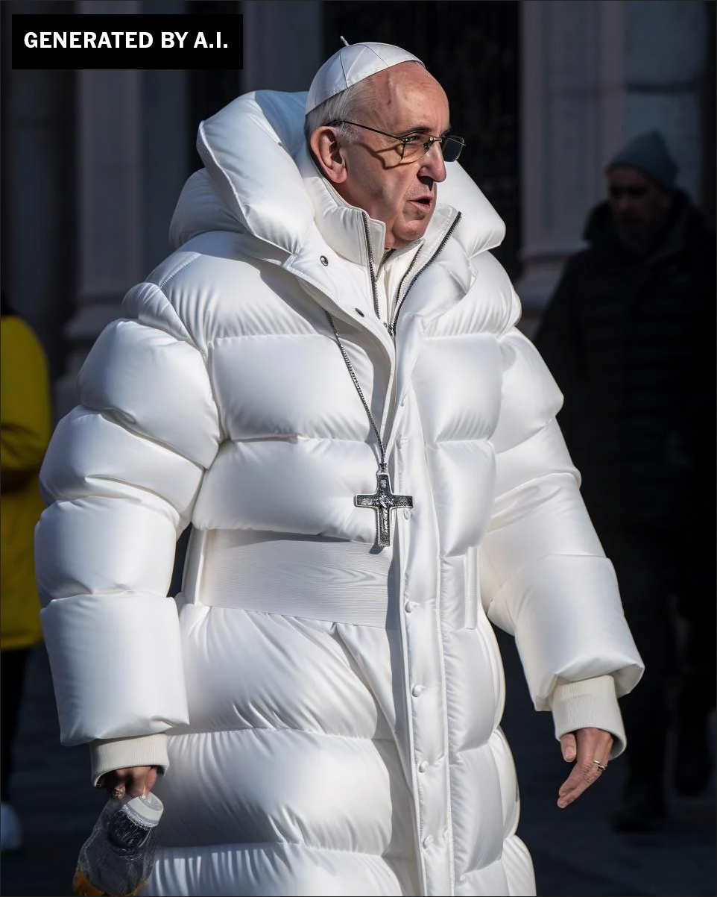
Human Images

Slide 8
Human Images: Context
Logic and Context of the Scene

Slide 9
Human Images: Hands and Limbs
Pay Attention to the Hands and Fingers

Slide 10
Human Images: Face
Pay Attention to the Face
Pay attention to the cheeks and forehead
Pay attention to the eyes and eyebrows
Pay attention to the glasses
Pay attention to facial hair
Pay attention to facial moles

Slide 11
Human Images: Clothing
Pay attention to the clothes
Warped Items
Missing and Extra items
Perspective and Geometry
Repetition in Detail
Material Texture

Slide 12
Human Image Check
Context of the scene
Hands and limbs of people
Face and facial features
Clothes and items

Slide 13
Human Image Check
Context of the scene
Hands and limbs of people
Face and facial features
Clothes and items

Slide 14
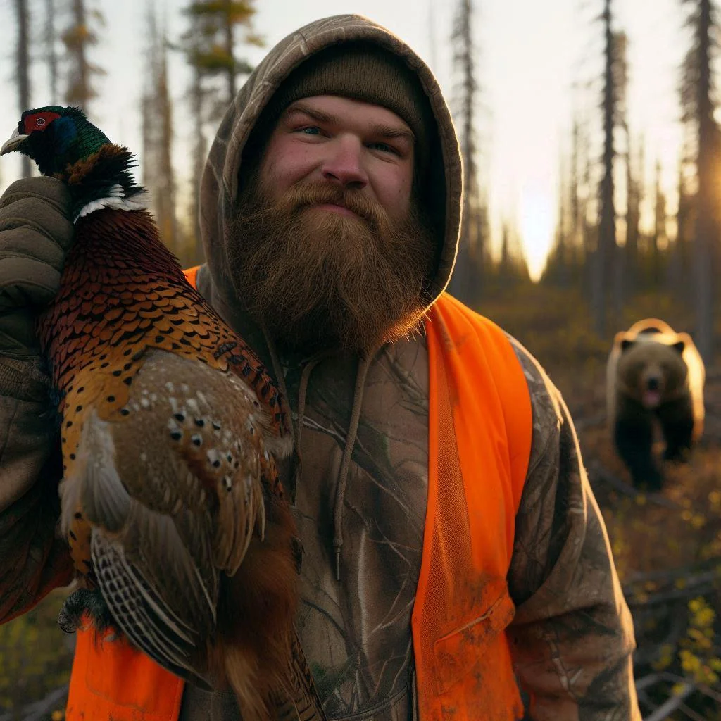
Human Images: Check On Learning
What do you notice?
Notes:
The scene, consider the bear sneaking up on him (bears can be noisy) See the extra drawstring on the hoody See the texture of the Visibility vest which is very different than outdoor gear

Slide 15
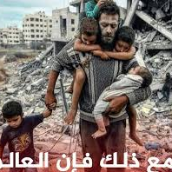
Human Images: Check On Learning
What do you notice?
Notes:
Notice the hands
Notice how long the boys shoulder would need to be
Notice the toes
Notice the dark figure in the background

Slide 16
Structure Image Check
Context of the scene
Structural Consistency
Material Texture
Lighting and Shadows
Perspective and Geometry
Repetition in Detail
Missing Elements
Nonsensical Object Placement
Disrupted Continuity
Anomalies in Common Patterns

Slide 17
Structure Image
What do you notice?
Notes:
the lanes are nonsensical
The green light on top
The Light posts seem odd
The signs and language seem nonsensical
Some of the cars have no tires
This is supposed to be a tesla but the wheels are off
The windshield seems to disappear in some areas.

Slide 18
Structure Image
Structural Consistency
Perspective and Geometry
Repetition in Detail
Nonsensical Object Placement
Anomalies in Common Patterns

Slide 19
Structure Image
Structural Consistency
Perspective and Geometry
Repetition in Detail
Nonsensical Object Placement
Anomalies in Common Patterns

Slide 20
Structure Image
Structural Consistency

Slide 21
Structure Image: Check On Learning
Context of the scene
Structural Consistency
Material Texture
Lighting and Shadows
Perspective and Geometry
Repetition in Detail
Missing Elements
Nonsensical Object Placement
Disrupted Continuity
Anomalies in Common Patterns

Slide 22
Structure Image Check
Context of the scene
Structural Consistency
Material Texture
Lighting and Shadows
Perspective and Geometry
Repetition in Detail
Missing Elements
Nonsensical Object Placement
Disrupted Continuity
Anomalies in Common Patterns

Slide 23
Synthetic Video Check: Practical Exercise
Context of the scene
Structural Consistency
Material Texture
Continue with Techniques…
Search online for possible deepfake videos that have been in the news
Analyze the video
Determine your own TTP for detecting synthetic videos
Present TTPs

Slide 24

Why Does It Matter To You?
Notes:
Show this video and story if students are having trouble understanding the impact. In China, AI transformed Ukrainian YouTuber into a Russian - https://www.reuters.com/technology/artificial-intelligence/china-ai-transformed-ukrainian-youtuber-into-russian-2024-06-21/; https://www.threads.net/@reuters/post/C8di0dli_iQ/?xmt=AQGzv6X0VtSp4e0P2Ejo6X-v0Zwm5I4Th7WRWGlMR97rWQ
### References
1. Media Lab at MIT on Detecting Fakes - https://www.media.mit.edu/projects/detect-fakes/overview/
2. Detect Fakes with Kellogg's online tool - https://detectfakes.kellogg.northwestern.edu/
3. CISA Contextualizing Deepfake Threats to Organizations - https://media.defense.gov/2023/Sep/12/2003298925/-1/-1/0/CSI-DEEPFAKE-THREATS.PDF
4. DARPA: Deepfake Defense Tech Ready for Commercialization, Transition - https://www.darpa.mil/news-events/2024-03-14#:~:text=Through%20the%20Semantic%20Forensics%20
5. Scribbr AI Detector - https://www.scribbr.com/ai-detector/
6. Real Bird Image Wins AI Contest - https://www.scientificamerican.com/article/how-this-real-image-won-an-ai-photo-competition/ (Image3-Real-Bird.webp)
7. Facebook Post with AI-Generated Image of Aligators - https://www.facebook.com/story.php?story_fbid=10105216423848582&id=199109935&mibextid=NoJtEM&rdid=3RMz451RwYXWUi4R (Image1-AI-Aligators.jpeg)
8. Reddit Post Believe it or not this image is AI - https://www.reddit.com/r/ChatGPT/comments/1c8u924/believe_it_or_not_this_image_is_ai/ (Image2-AI-Car.webp)
9. Journalist's Car - https://cpj.org/2023/11/photos-israel-hamas-war-takes-unprecedented-toll-on-journalists/ (Image4-Real-Car.jpg)
10. Image of Man Hunting - https://www.reddit.com/r/aiArt/comments/1dkn336/most_realistic_image_ive_prompted/ (Image5-Real-Hunting_Bear.webp)
11. How to Spot a Deepfake - https://time.com/6266606/how-to-spot-deepfake-pope/ (Image6-AI-Pope.png)
12. X Post about Mob attacking Journalist - https://x.com/AbujomaaGaza/status/1798366219546071081 (Image7-Real-Mob_Journalist.jpg)
13. Man Carrying Kids out of Gaza Fact Check - https://factcheck.afp.com/doc.afp.com.33ZJ8WU (Image8-AI-Man_Carrying_Kids.jpg) (Image8-AI-Man_Carrying_Kids.jpeg, Image9-AI-FACTHCHECK-Man_Carrying_Kids.jpeg)
14. Reddit community focused on AI Art - https://www.reddit.com/r/aiArt/
15. In China, AI transformed Ukrainian YouTuber into a Russian - https://www.reuters.com/technology/artificial-intelligence/china-ai-transformed-ukrainian-youtuber-into-russian-2024-06-21/; https://www.threads.net/@reuters/post/C8di0dli_iQ/?xmt=AQGzv6X0VtSp4e0P2Ejo6X-v0Zwm5I4Th7WRWGlMR97rWQ

Slide 25
References
1. Media Lab at MIT on Detecting Fakes - https://www.media.mit.edu/projects/detect-fakes/overview/
2. Detect Fakes with Kellogg's online tool - https://detectfakes.kellogg.northwestern.edu/
3. CISA Contextualizing Deepfake Threats to Organizations - https://media.defense.gov/2023/Sep/12/2003298925/-1/-1/0/CSI-DEEPFAKE-THREATS.PDF
4. DARPA: Deepfake Defense Tech Ready for Commercialization, Transition - https://www.darpa.mil/news-events/2024-03-14#:~:text=Through%20the%20Semantic%20Forensics%20
Notes:
### References
1. Media Lab at MIT on Detecting Fakes - https://www.media.mit.edu/projects/detect-fakes/overview/
2. Detect Fakes with Kellogg's online tool - https://detectfakes.kellogg.northwestern.edu/
3. CISA Contextualizing Deepfake Threats to Organizations - https://media.defense.gov/2023/Sep/12/2003298925/-1/-1/0/CSI-DEEPFAKE-THREATS.PDF
4. DARPA: Deepfake Defense Tech Ready for Commercialization, Transition - https://www.darpa.mil/news-events/2024-03-14#:~:text=Through%20the%20Semantic%20Forensics%20
5. Scribbr AI Detector - https://www.scribbr.com/ai-detector/
6. Real Bird Image Wins AI Contest - https://www.scientificamerican.com/article/how-this-real-image-won-an-ai-photo-competition/ (Image3-Real-Bird.webp)
7. Facebook Post with AI-Generated Image of Aligators - https://www.facebook.com/story.php?story_fbid=10105216423848582&id=199109935&mibextid=NoJtEM&rdid=3RMz451RwYXWUi4R (Image1-AI-Aligators.jpeg)
8. Reddit Post Believe it or not this image is AI - https://www.reddit.com/r/ChatGPT/comments/1c8u924/believe_it_or_not_this_image_is_ai/ (Image2-AI-Car.webp)
9. Journalist's Car - https://cpj.org/2023/11/photos-israel-hamas-war-takes-unprecedented-toll-on-journalists/ (Image4-Real-Car.jpg)
10. Image of Man Hunting - https://www.reddit.com/r/aiArt/comments/1dkn336/most_realistic_image_ive_prompted/ (Image5-Real-Hunting_Bear.webp)
11. How to Spot a Deepfake - https://time.com/6266606/how-to-spot-deepfake-pope/ (Image6-AI-Pope.png)
12. X Post about Mob attacking Journalist - https://x.com/AbujomaaGaza/status/1798366219546071081 (Image7-Real-Mob_Journalist.jpg)
13. Man Carrying Kids out of Gaza Fact Check - https://factcheck.afp.com/doc.afp.com.33ZJ8WU (Image8-AI-Man_Carrying_Kids.jpg) (Image8-AI-Man_Carrying_Kids.jpeg, Image9-AI-FACTHCHECK-Man_Carrying_Kids.jpeg)
14. Reddit community focused on AI Art - https://www.reddit.com/r/aiArt/
15. In China, AI transformed Ukrainian YouTuber into a Russian - https://www.reuters.com/technology/artificial-intelligence/china-ai-transformed-ukrainian-youtuber-into-russian-2024-06-21/; https://www.threads.net/@reuters/post/C8di0dli_iQ/?xmt=AQGzv6X0VtSp4e0P2Ejo6X-v0Zwm5I4Th7WRWGlMR97rWQ

Slide 26

TAKE A BREAK
Return By: XX:XX

